Slide 1
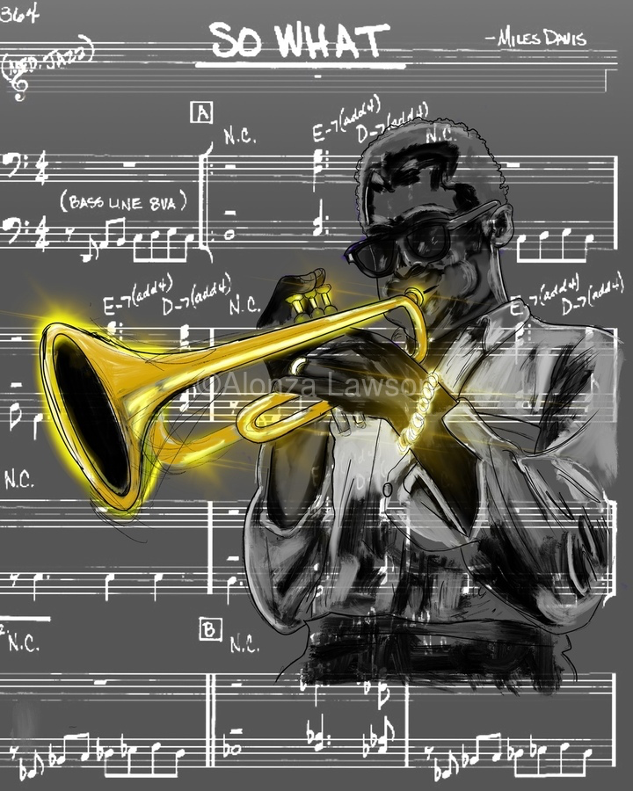
Measuring intention and emotional involvement in jazz improvisations
Anna Jordanous
Notes:
Hypothesis: • if an improvisation contains more evidence of emotion-laden content, it is more likely to be recognised as creative What do I need • data ranking most creative improvisations • data for multiple improvisations • ml model eg transformer trained on valence/arousal (soleymani et al?) - benetos et al 2021? Assumption that git repo using Spotipy won't work any more • library to calculate J&L features - librosa? Super collider? • do I want to get human input for validation? Or is the ranking enough? • Data on popularity of artists in dataset (spotipy?) • Literature survey on MER music emotion recognition, especially anything looking at creativity- MAY INFLUENCE METHOD • Stats method to analyse results across songs • organising data into sets for analysis, need to cross check against data on popularity+year as well as matching across a lead sheet • check for different songs with same name eg moaning Method • collect data as above • implement J&L features for input audio with 5d vector as output (is this actually the first paper? See issues)(and Russell model? With 2d output vector, to see if overall emotion has effect). Output = emovectors? (Check if that had been used) • Get emovectors :) for each song in analysis data • Statistical analysis across songs matched to ranking to verify hypothesis Issues • isolating individual improvisations vs analysing the whole track- this needs to be clearly linked to the rankings • rankings need to be very solid benchmarks • Is the impro creative because of the individual improvising, or the group? I assume collective creativity - why? Because music impro is inherently social (citation) and group impro is constructed around interaction (cite, jazz theory examples too) * to what extent does the chord sequence/ lead sheet melody influence creativity? In this work, this is controlled for through analysing multiple examples over the same chord sequence. Where possible, will also compare improvisations seeded from different lead sheet melodies, using the same chord sequence eg 12 bar blues, rhythm changes * Rankings will be biased by popularity of the musicians involved and how well known they are - control by looking at tracks matched by rough date, and also will be interesting to evaluate newer tracks by lesser known artists - can I detect up and coming stars? (Can use spotipy for metadata on artist popularity, will need to be scaled relative to all jazz artists in my dataset) * jazz is a term that covers many sub genres, how appropriate is it to compare, say free jazz to dixie? ..... maybe can check this in analysis if deep enough data * what about improvisations that aren't jazz? Maybe i need to be careful here and say 'impro' rather than jazz, though that might not work as the leadsheet/chord sequence idea is inspired by jazz. I need to be careful how to frame this. I can emphasise my scope is on improvisations around a lead sheet/ chord sequence model (explain what this is), typically but not exclusively found in jazz impro... acknowledging too that not all jazz is in this model (I can cite Alex Hawkins as example!) * I assume that for J&L all audio features contribute equally to the emotion... check original paper and any follow up work. Can i validate this against any annotated datasets (ideally jazz)? Is this actually the first paper? * is it worth doing analysis across an artist, to calculate their most creative impro? Might be verifiable against people's rankings? Controversial again otherwise, but possible. Difficulty with groups- what is the artist? The lead name on the record? Or that specific combination of musicians? Could be a fun initial experiment pointing to future work? Assumptions: * Improvisation is creative process where the outputs are closely tied to the live process. • emotional content in the music can be used as a proxy for emotional involvement • emotional content can be represented using either Russell valence and arousal model or the 5 key emotions as captured by Juslin and Laukka. Russell ok for summative but not for magnitude, so J&L better? • Intention and emotional involvement are recognised outside my work, as part of the key contributors to musical creativity (alongside social interaction and communication, and domain competence) • I can use 'song' or 'chart' to represent lead sheet plus chord (chart probably better, but more confusing for a non jazzer?) Future work • intention - can this be captured by showing presence of a musical narrative? How? • how does the chord sequence influence creativity potential? Future work on optimising chord sequences for creativity • could analyse creativity of an individual artist across different groups.. see in what groups they (collectively) produce most creative impro..... but difficult to do without

Slide 2
Today’s talk: Measuring intention and emotional involvement in jazz music
Overview of this work in progress
Part of a wider project on optimising AI for creativity
Background
Creativity in music improvisation
Emotions in music
Methodology and results so far
So What? and Next steps
Summary
Notes:
Hypothesis: • if an improvisation contains more evidence of emotion-laden content, it is more likely to be recognised as creative What do I need • data ranking most creative improvisations • data for multiple improvisations • ml model eg transformer trained on valence/arousal (soleymani et al?) - benetos et al 2021? Assumption that git repo using Spotipy won't work any more • library to calculate J&L features - librosa? Super collider? • do I want to get human input for validation? Or is the ranking enough? • Data on popularity of artists in dataset (spotipy?) • Literature survey on MER music emotion recognition, especially anything looking at creativity- MAY INFLUENCE METHOD • Stats method to analyse results across songs • organising data into sets for analysis, need to cross check against data on popularity+year as well as matching across a lead sheet • check for different songs with same name eg moaning Method • collect data as above • implement J&L features for input audio with 5d vector as output (is this actually the first paper? See issues)(and Russell model? With 2d output vector, to see if overall emotion has effect). Output = emovectors? (Check if that had been used) • Get emovectors :) for each song in analysis data • Statistical analysis across songs matched to ranking to verify hypothesis Issues • isolating individual improvisations vs analysing the whole track- this needs to be clearly linked to the rankings • rankings need to be very solid benchmarks • Is the impro creative because of the individual improvising, or the group? I assume collective creativity - why? Because music impro is inherently social (citation) and group impro is constructed around interaction (cite, jazz theory examples too) * to what extent does the chord sequence/ lead sheet melody influence creativity? In this work, this is controlled for through analysing multiple examples over the same chord sequence. Where possible, will also compare improvisations seeded from different lead sheet melodies, using the same chord sequence eg 12 bar blues, rhythm changes * Rankings will be biased by popularity of the musicians involved and how well known they are - control by looking at tracks matched by rough date, and also will be interesting to evaluate newer tracks by lesser known artists - can I detect up and coming stars? (Can use spotipy for metadata on artist popularity, will need to be scaled relative to all jazz artists in my dataset) * jazz is a term that covers many sub genres, how appropriate is it to compare, say free jazz to dixie? ..... maybe can check this in analysis if deep enough data * what about improvisations that aren't jazz? Maybe i need to be careful here and say 'impro' rather than jazz, though that might not work as the leadsheet/chord sequence idea is inspired by jazz. I need to be careful how to frame this. I can emphasise my scope is on improvisations around a lead sheet/ chord sequence model (explain what this is), typically but not exclusively found in jazz impro... acknowledging too that not all jazz is in this model (I can cite Alex Hawkins as example!) * I assume that for J&L all audio features contribute equally to the emotion... check original paper and any follow up work. Can i validate this against any annotated datasets (ideally jazz)? Is this actually the first paper? * is it worth doing analysis across an artist, to calculate their most creative impro? Might be verifiable against people's rankings? Controversial again otherwise, but possible. Difficulty with groups- what is the artist? The lead name on the record? Or that specific combination of musicians? Could be a fun initial experiment pointing to future work? Assumptions: * Improvisation is creative process where the outputs are closely tied to the live process. • emotional content in the music can be used as a proxy for emotional involvement • emotional content can be represented using either Russell valence and arousal model or the 5 key emotions as captured by Juslin and Laukka. Russell ok for summative but not for magnitude, so J&L better? • Intention and emotional involvement are recognised outside my work, as part of the key contributors to musical creativity (alongside social interaction and communication, and domain competence) • I can use 'song' or 'chart' to represent lead sheet plus chord (chart probably better, but more confusing for a non jazzer?) Future work • intention - can this be captured by showing presence of a musical narrative? How? • how does the chord sequence influence creativity potential? Future work on optimising chord sequences for creativity • could analyse creativity of an individual artist across different groups.. see in what groups they (collectively) produce most creative impro..... but difficult to do without

Slide 3
Overview – work in progress
This work is part of a wider project on optimising AI for creativity:
“MOOsic: Optimising AI Music Creativity Using Nature-Inspired Multi-Objective Optimisation”
“Creativity is a crucial part of intelligence (and vice versa). Imagine an intelligence without creativity? This project explores the hypothesis that we can optimise Generative AI to be more creative, using multi-objective optimisation.” …
“This project investigates the hypothesis that we can approximate creativity evaluation with domain-specific evaluative tests , such that we can optimise for maximising creativity. … [this project] looks specifically at musical improvisation, and investigates how automated tests for musical improvisation creativity can be implemented and applied.
Notes:
The evaluation of creativity is based on automating tests of the three criteria identified above as most
contributory to musical improvisation creativity.
We propose using a nature inspired multi-objective optimisation (MOO) based approach, optimising across
multiple factors to maximise the creativity of the musical output. We will evaluate different MOO-based
approaches such as lexicographic and Pareto based algorithms, comparing them to each other, and to
current state of the art in music generation techniques. We will evaluate a hypothesis that a Pareto-front
approach is particularly well suited to this task. Over other approaches to MOO, such as a lexicographic-
based approach or weighted formula that require additional information (lexicographic ordering) or optimi-
sation steps (objective weights).
Music improvisation creativity is influenced by three key factors [7], which we treat here as three key ob-
jectives for optimisation. We use current state of the art music generators and evaluate whether the intro-
duction of multi-objective optimisation increases the perceived creativity of the generated output. and this
allows us to incorporate evaluation in the creative process of music generators.
These proposals (implementing creativity metrics in multi-objective optimisation) are the first to use cre-
ativity evaluation to enable transformer-based AI software to develop more creativity algorithmically.

Slide 4

Creativity evaluation – how do we test for creativity?
Q. What is creativity?

Slide 5
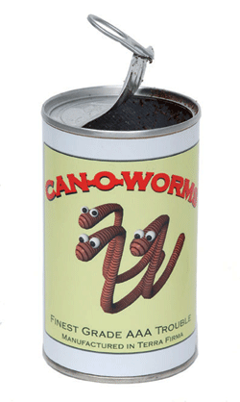
This working definition of creativity is ok… isn’t it?
Creativity =
novelty
+ value
+ …??

Slide 6
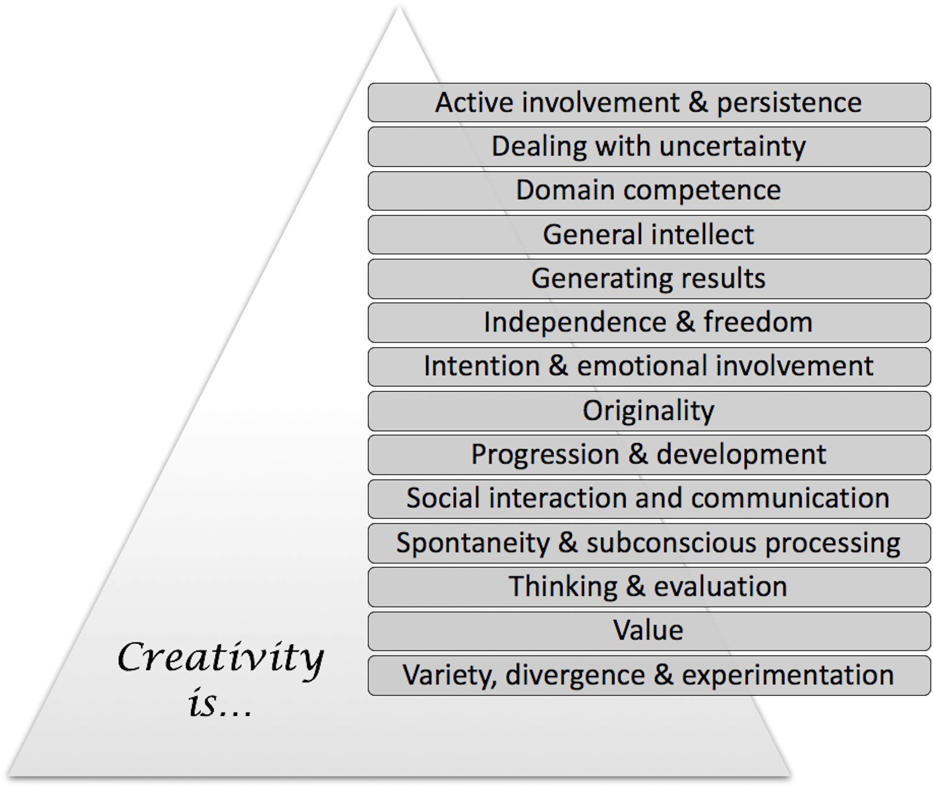
Key components of creativity (using statistical models and clustering)
Jordanous, Anna and Keller, Bill (2016) Modelling Creativity: Identifying Key Components through a Corpus-Based Approach. PLoS ONE 11(10): e0162959.
https://doi.org/10.1371/journal.pone.0162959

Slide 7
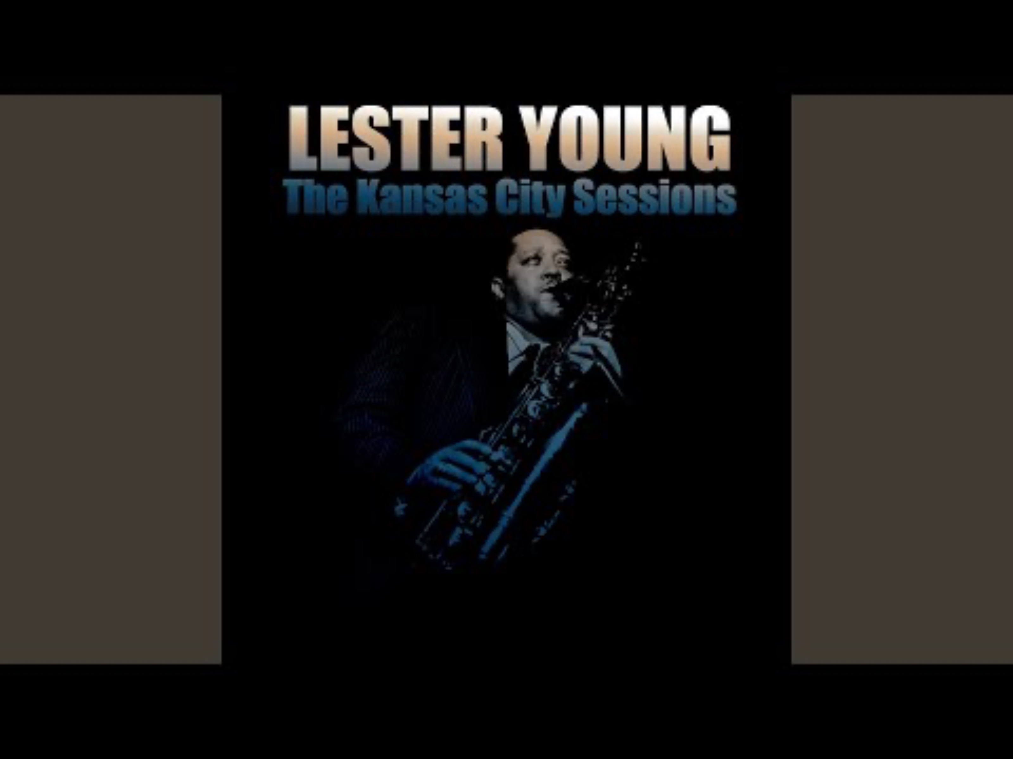
Background: jazz improvisation
https://listenbrainz.org/player/?recording_mbids=78c43c1b-6394-40af-ac4f-bdffe63c274b
Notes:
Hypothesis: • if an improvisation contains more evidence of emotion-laden content, it is more likely to be recognised as creative What do I need • data ranking most creative improvisations • data for multiple improvisations • ml model eg transformer trained on valence/arousal (soleymani et al?) - benetos et al 2021? Assumption that git repo using Spotipy won't work any more • library to calculate J&L features - librosa? Super collider? • do I want to get human input for validation? Or is the ranking enough? • Data on popularity of artists in dataset (spotipy?) • Literature survey on MER music emotion recognition, especially anything looking at creativity- MAY INFLUENCE METHOD • Stats method to analyse results across songs • organising data into sets for analysis, need to cross check against data on popularity+year as well as matching across a lead sheet • check for different songs with same name eg moaning Method • collect data as above • implement J&L features for input audio with 5d vector as output (is this actually the first paper? See issues)(and Russell model? With 2d output vector, to see if overall emotion has effect). Output = emovectors? (Check if that had been used) • Get emovectors :) for each song in analysis data • Statistical analysis across songs matched to ranking to verify hypothesis Issues • isolating individual improvisations vs analysing the whole track- this needs to be clearly linked to the rankings • rankings need to be very solid benchmarks • Is the impro creative because of the individual improvising, or the group? I assume collective creativity - why? Because music impro is inherently social (citation) and group impro is constructed around interaction (cite, jazz theory examples too) * to what extent does the chord sequence/ lead sheet melody influence creativity? In this work, this is controlled for through analysing multiple examples over the same chord sequence. Where possible, will also compare improvisations seeded from different lead sheet melodies, using the same chord sequence eg 12 bar blues, rhythm changes * Rankings will be biased by popularity of the musicians involved and how well known they are - control by looking at tracks matched by rough date, and also will be interesting to evaluate newer tracks by lesser known artists - can I detect up and coming stars? (Can use spotipy for metadata on artist popularity, will need to be scaled relative to all jazz artists in my dataset) * jazz is a term that covers many sub genres, how appropriate is it to compare, say free jazz to dixie? ..... maybe can check this in analysis if deep enough data * what about improvisations that aren't jazz? Maybe i need to be careful here and say 'impro' rather than jazz, though that might not work as the leadsheet/chord sequence idea is inspired by jazz. I need to be careful how to frame this. I can emphasise my scope is on improvisations around a lead sheet/ chord sequence model (explain what this is), typically but not exclusively found in jazz impro... acknowledging too that not all jazz is in this model (I can cite Alex Hawkins as example!) * I assume that for J&L all audio features contribute equally to the emotion... check original paper and any follow up work. Can i validate this against any annotated datasets (ideally jazz)? Is this actually the first paper? * is it worth doing analysis across an artist, to calculate their most creative impro? Might be verifiable against people's rankings? Controversial again otherwise, but possible. Difficulty with groups- what is the artist? The lead name on the record? Or that specific combination of musicians? Could be a fun initial experiment pointing to future work? Assumptions: * Improvisation is creative process where the outputs are closely tied to the live process. • emotional content in the music can be used as a proxy for emotional involvement • emotional content can be represented using either Russell valence and arousal model or the 5 key emotions as captured by Juslin and Laukka. Russell ok for summative but not for magnitude, so J&L better? • Intention and emotional involvement are recognised outside my work, as part of the key contributors to musical creativity (alongside social interaction and communication, and domain competence) • I can use 'song' or 'chart' to represent lead sheet plus chord (chart probably better, but more confusing for a non jazzer?) Future work • intention - can this be captured by showing presence of a musical narrative? How? • how does the chord sequence influence creativity potential? Future work on optimising chord sequences for creativity • could analyse creativity of an individual artist across different groups.. see in what groups they (collectively) produce most creative impro..... but difficult to do without

Slide 8
What is musical creativity? And what is improvisation?
Undefinable?
Bailey (1993): the creative process exists at a level beyond that which can be expressed in words; ‘musical creativity (all creativity?) is indivisible’
Lewis (2011): improvisation is ‘the ubiquitous practice of everyday life’, communicating meaning and emotion such that while improvising, ‘one hears something of oneself’
The same thing?
Improvisation and creativity are often conflated by authors rather than being distinguished as different behaviours (e.g. Sawyer 1999, Thom 2003, Johnson-Laird 2002, Biasutti and Frezza 2009, Gibbs 2010).
Something that can be defined more tangibly? Let’s see…
Jordanous, Anna, Keller, Bill (2012) What makes a musical improvisation creative? Journal of Interdisciplinary Music Studies, 6 (2). pp. 151-175.
Notes:
Hypothesis: • if an improvisation contains more evidence of emotion-laden content, it is more likely to be recognised as creative What do I need • data ranking most creative improvisations • data for multiple improvisations • ml model eg transformer trained on valence/arousal (soleymani et al?) - benetos et al 2021? Assumption that git repo using Spotipy won't work any more • library to calculate J&L features - librosa? Super collider? • do I want to get human input for validation? Or is the ranking enough? • Data on popularity of artists in dataset (spotipy?) • Literature survey on MER music emotion recognition, especially anything looking at creativity- MAY INFLUENCE METHOD • Stats method to analyse results across songs • organising data into sets for analysis, need to cross check against data on popularity+year as well as matching across a lead sheet • check for different songs with same name eg moaning Method • collect data as above • implement J&L features for input audio with 5d vector as output (is this actually the first paper? See issues)(and Russell model? With 2d output vector, to see if overall emotion has effect). Output = emovectors? (Check if that had been used) • Get emovectors :) for each song in analysis data • Statistical analysis across songs matched to ranking to verify hypothesis Issues • isolating individual improvisations vs analysing the whole track- this needs to be clearly linked to the rankings • rankings need to be very solid benchmarks • Is the impro creative because of the individual improvising, or the group? I assume collective creativity - why? Because music impro is inherently social (citation) and group impro is constructed around interaction (cite, jazz theory examples too) * to what extent does the chord sequence/ lead sheet melody influence creativity? In this work, this is controlled for through analysing multiple examples over the same chord sequence. Where possible, will also compare improvisations seeded from different lead sheet melodies, using the same chord sequence eg 12 bar blues, rhythm changes * Rankings will be biased by popularity of the musicians involved and how well known they are - control by looking at tracks matched by rough date, and also will be interesting to evaluate newer tracks by lesser known artists - can I detect up and coming stars? (Can use spotipy for metadata on artist popularity, will need to be scaled relative to all jazz artists in my dataset) * jazz is a term that covers many sub genres, how appropriate is it to compare, say free jazz to dixie? ..... maybe can check this in analysis if deep enough data * what about improvisations that aren't jazz? Maybe i need to be careful here and say 'impro' rather than jazz, though that might not work as the leadsheet/chord sequence idea is inspired by jazz. I need to be careful how to frame this. I can emphasise my scope is on improvisations around a lead sheet/ chord sequence model (explain what this is), typically but not exclusively found in jazz impro... acknowledging too that not all jazz is in this model (I can cite Alex Hawkins as example!) * I assume that for J&L all audio features contribute equally to the emotion... check original paper and any follow up work. Can i validate this against any annotated datasets (ideally jazz)? Is this actually the first paper? * is it worth doing analysis across an artist, to calculate their most creative impro? Might be verifiable against people's rankings? Controversial again otherwise, but possible. Difficulty with groups- what is the artist? The lead name on the record? Or that specific combination of musicians? Could be a fun initial experiment pointing to future work? Assumptions: * Improvisation is creative process where the outputs are closely tied to the live process. • emotional content in the music can be used as a proxy for emotional involvement • emotional content can be represented using either Russell valence and arousal model or the 5 key emotions as captured by Juslin and Laukka. Russell ok for summative but not for magnitude, so J&L better? • Intention and emotional involvement are recognised outside my work, as part of the key contributors to musical creativity (alongside social interaction and communication, and domain competence) • I can use 'song' or 'chart' to represent lead sheet plus chord (chart probably better, but more confusing for a non jazzer?) Future work • intention - can this be captured by showing presence of a musical narrative? How? • how does the chord sequence influence creativity potential? Future work on optimising chord sequences for creativity • could analyse creativity of an individual artist across different groups.. see in what groups they (collectively) produce most creative impro..... but difficult to do without

Slide 9
What constitutes music impro creativity?
Proposed frameworks
Johnson-Laird (2002): 5 part creative processes (forming the ‘NONCE definition of creativity’): ‘Novel for the individual, Optionally novel for society, Nondeterministic, dependent on Criteria or constraints, and based on Existing elements’.
Neural evidence (Csikszentmihalyi 2009; Friis-Olivarius et al. 2009; Berkowitz & Ansari 2010) shows that brain activity during improvisation relates to brain activity when making choices.
Predictability vs structured expertise?
Berliner (1994): musical improvisers need to balance the known and unknown, working simultaneously with planned conscious thought processes and subconscious emergence of ideas
Berliner (1994): musical improvisers learn from studying others, then develop that knowledge for a unique style. Thom (2003) warns the use of too much domain knowledge in a computational model would inhibit creativity.
Gibbs highlights invention and originality as two key components for creative improvisation (Gibbs, 2010).
Choices vs freedom?
Biasutti and Frezza (2009): unpredictability and use of structures are two ends of a spectrum. The more creative an impro, the more unpredictability is demonstrated. Similarly, the more structure, the less creativity (and v.v)
Biasutti and Frezza (2009) identify seven dimensions of improvisation: anticipation, emotive communication, flow, feedback, use of repertoire, musical practice and basic skills.
Lewis (2011): a choice of what expressive actions to perform in improvisation and liberty on when to perform them. Uses neural evidence to claim that one is never fully in control during improvisation
Summary – lots of useful contributions on creativity in musical improvisation but no overall consensus on how that creativity is manifested.
Jordanous, Anna, Keller, Bill (2012) What makes a musical improvisation creative? Journal of Interdisciplinary Music Studies, 6 (2). pp. 151-175.
Notes:
Hypothesis: • if an improvisation contains more evidence of emotion-laden content, it is more likely to be recognised as creative What do I need • data ranking most creative improvisations • data for multiple improvisations • ml model eg transformer trained on valence/arousal (soleymani et al?) - benetos et al 2021? Assumption that git repo using Spotipy won't work any more • library to calculate J&L features - librosa? Super collider? • do I want to get human input for validation? Or is the ranking enough? • Data on popularity of artists in dataset (spotipy?) • Literature survey on MER music emotion recognition, especially anything looking at creativity- MAY INFLUENCE METHOD • Stats method to analyse results across songs • organising data into sets for analysis, need to cross check against data on popularity+year as well as matching across a lead sheet • check for different songs with same name eg moaning Method • collect data as above • implement J&L features for input audio with 5d vector as output (is this actually the first paper? See issues)(and Russell model? With 2d output vector, to see if overall emotion has effect). Output = emovectors? (Check if that had been used) • Get emovectors :) for each song in analysis data • Statistical analysis across songs matched to ranking to verify hypothesis Issues • isolating individual improvisations vs analysing the whole track- this needs to be clearly linked to the rankings • rankings need to be very solid benchmarks • Is the impro creative because of the individual improvising, or the group? I assume collective creativity - why? Because music impro is inherently social (citation) and group impro is constructed around interaction (cite, jazz theory examples too) * to what extent does the chord sequence/ lead sheet melody influence creativity? In this work, this is controlled for through analysing multiple examples over the same chord sequence. Where possible, will also compare improvisations seeded from different lead sheet melodies, using the same chord sequence eg 12 bar blues, rhythm changes * Rankings will be biased by popularity of the musicians involved and how well known they are - control by looking at tracks matched by rough date, and also will be interesting to evaluate newer tracks by lesser known artists - can I detect up and coming stars? (Can use spotipy for metadata on artist popularity, will need to be scaled relative to all jazz artists in my dataset) * jazz is a term that covers many sub genres, how appropriate is it to compare, say free jazz to dixie? ..... maybe can check this in analysis if deep enough data * what about improvisations that aren't jazz? Maybe i need to be careful here and say 'impro' rather than jazz, though that might not work as the leadsheet/chord sequence idea is inspired by jazz. I need to be careful how to frame this. I can emphasise my scope is on improvisations around a lead sheet/ chord sequence model (explain what this is), typically but not exclusively found in jazz impro... acknowledging too that not all jazz is in this model (I can cite Alex Hawkins as example!) * I assume that for J&L all audio features contribute equally to the emotion... check original paper and any follow up work. Can i validate this against any annotated datasets (ideally jazz)? Is this actually the first paper? * is it worth doing analysis across an artist, to calculate their most creative impro? Might be verifiable against people's rankings? Controversial again otherwise, but possible. Difficulty with groups- what is the artist? The lead name on the record? Or that specific combination of musicians? Could be a fun initial experiment pointing to future work? Assumptions: * Improvisation is creative process where the outputs are closely tied to the live process. • emotional content in the music can be used as a proxy for emotional involvement • emotional content can be represented using either Russell valence and arousal model or the 5 key emotions as captured by Juslin and Laukka. Russell ok for summative but not for magnitude, so J&L better? • Intention and emotional involvement are recognised outside my work, as part of the key contributors to musical creativity (alongside social interaction and communication, and domain competence) • I can use 'song' or 'chart' to represent lead sheet plus chord (chart probably better, but more confusing for a non jazzer?) Future work • intention - can this be captured by showing presence of a musical narrative? How? • how does the chord sequence influence creativity potential? Future work on optimising chord sequences for creativity • could analyse creativity of an individual artist across different groups.. see in what groups they (collectively) produce most creative impro..... but difficult to do without

Slide 10
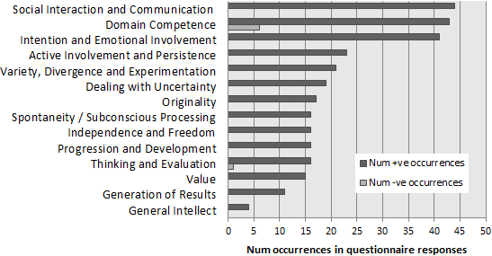
Key components of creativity – mapping to musical improvisation creativity
Hypothesis:
if an improvisation contains more evidence of emotion-laden content, it is more likely to be recognised as creative

Slide 11
Computational modelling of emotion
how to model human emotions in a computational way?
so computers can detect and respond to people’s emotions
two leading theories for representing emotion:
Russell’s circumplex model (Russell, 1980)
Ekman’s five/six basic emotions (Ekman, 1992)
(there are others, e.g. Plutnik’s wheel of emotion, etc)

Slide 12
Computational modelling of emotion: Russell’s circumplex model of emotion
Russell, J. A. (1980) ‘‘A Circumplex Model of Affect’’, Journal of Personality and Social Psychology 39: 1161–78.

Slide 13
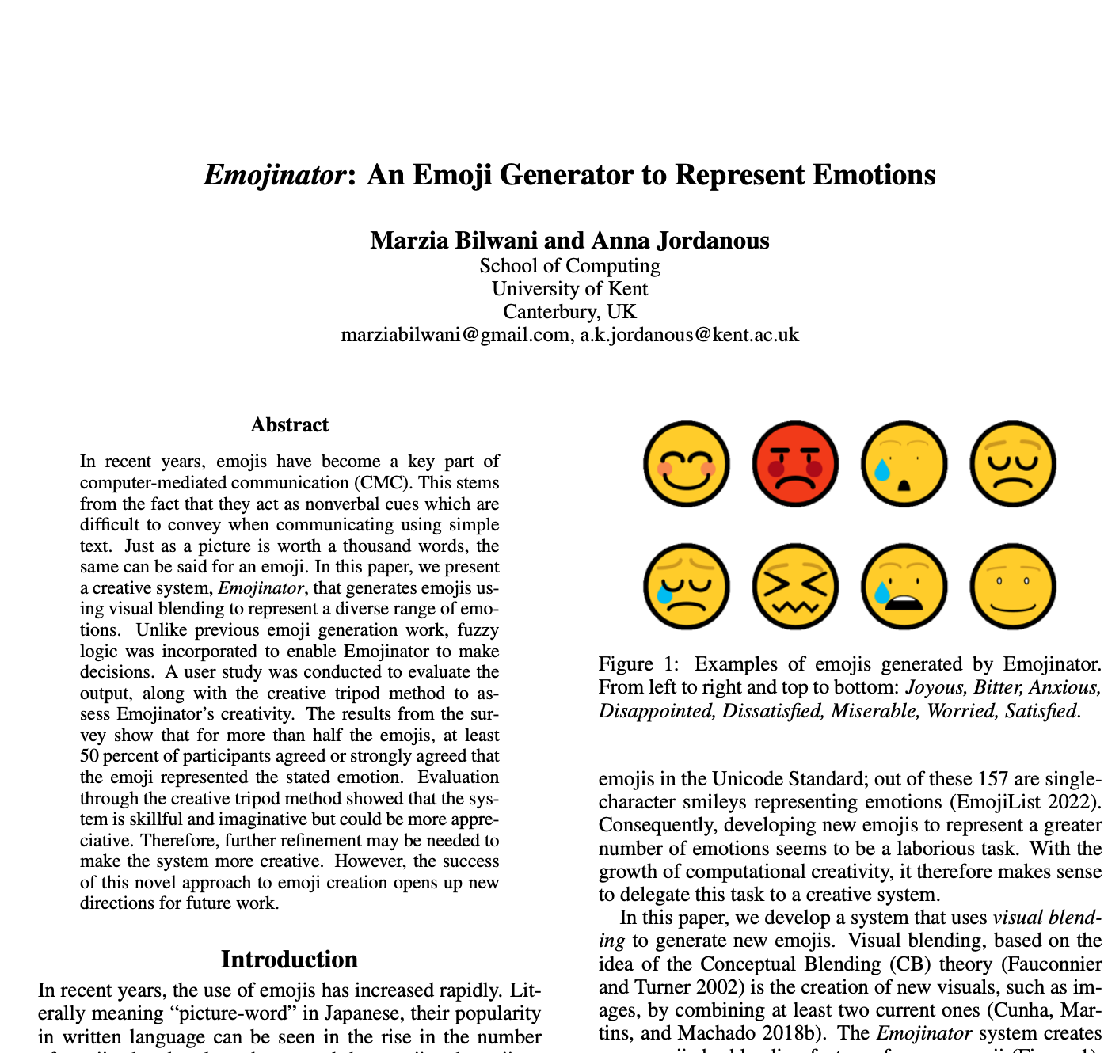
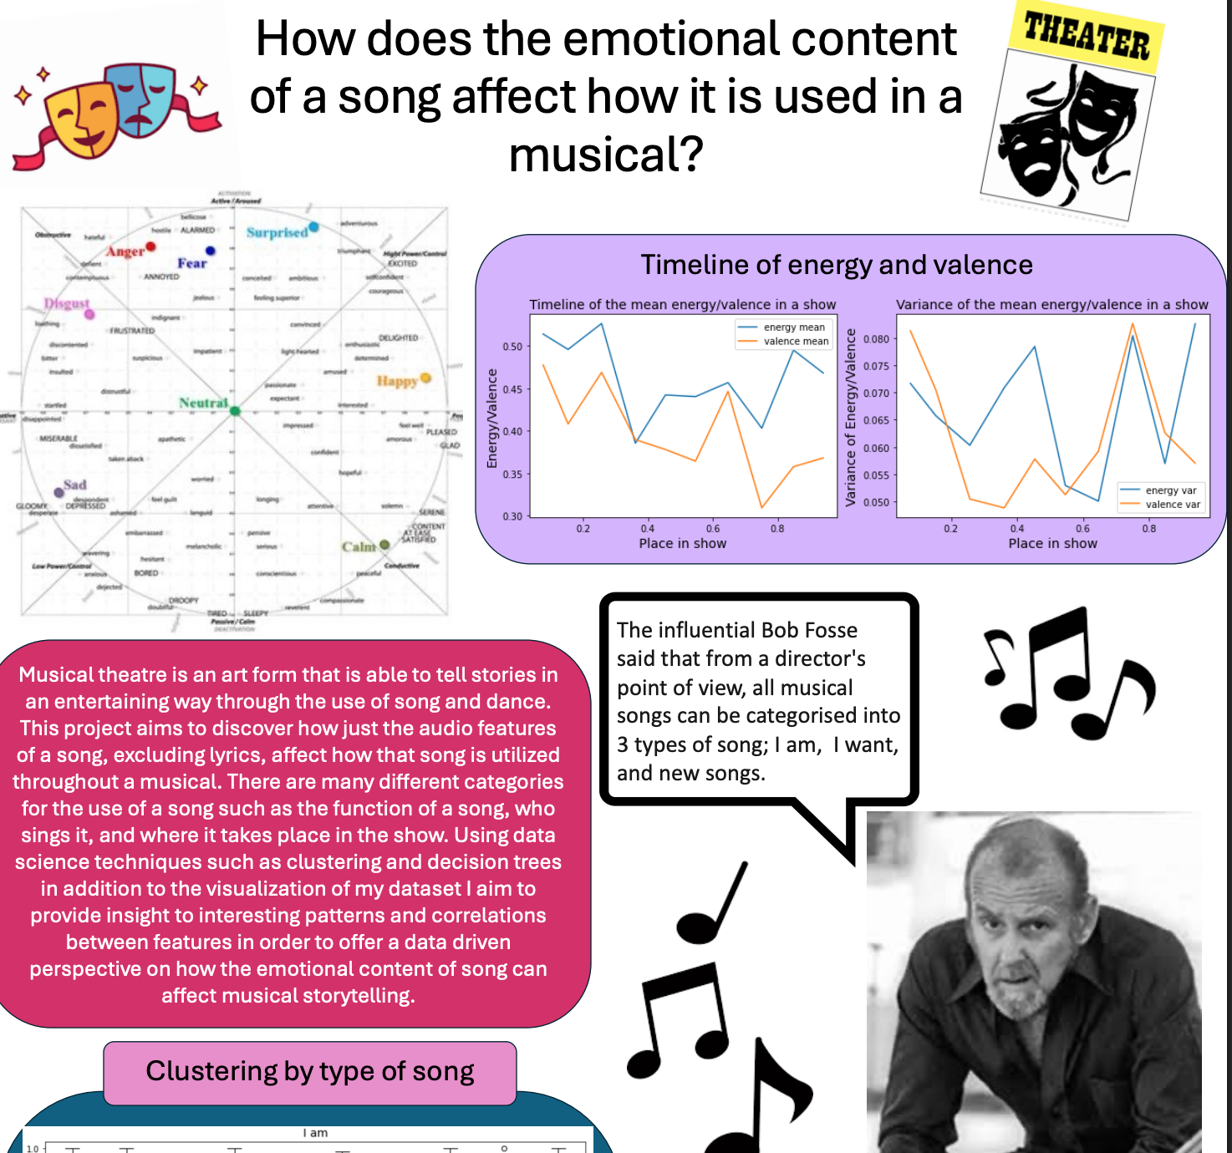
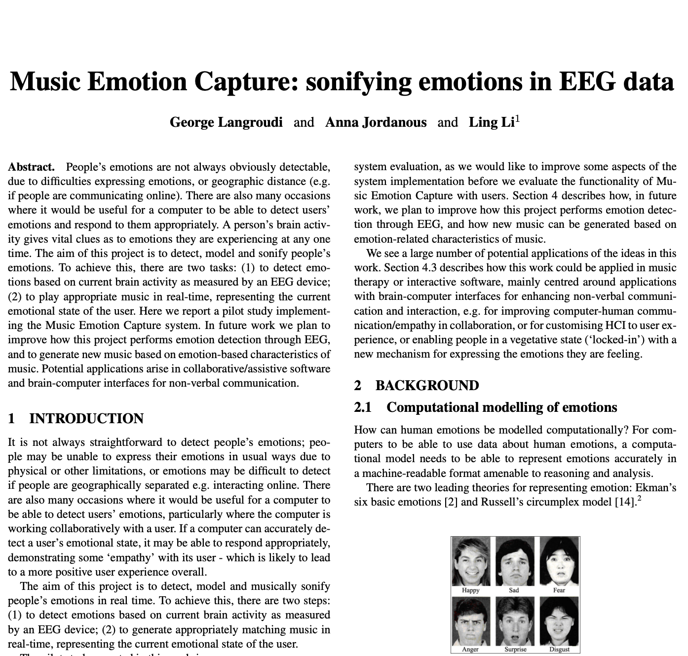
Computational modelling of emotion: Russell++
K.R. Scherer, “What Are Emotions? And How Can They Be Measured?” Social Science Information, vol. 44, no. 4, pp. 695-729, 2005.
Paltoglou, G., & Thelwall, M. (2013). Seeing stars of valence and arousal in blog posts. IEEE Transactions on Affective Computing, 4(1), 116–123.

Slide 14
Computational modelling of emotion: Ekman’s five/six basic emotions
Ekman, P. (1992). An argument for basic emotions. Cognition & Emotion. http://doi.org/10.1080/02699939208411068
https://ocw.mit.edu/courses/brain-and-cognitive-sciences/9-00sc-introduction-to-psychology-fall-2011/emotion-motivation/discussion-emotion/diss_img.jpg

Slide 15
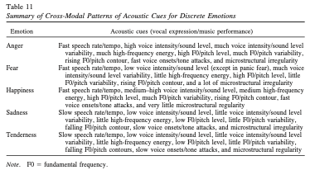
Emotions in music
Summary of Cross-Modal Patterns of Acoustic Cues for Discrete Emotions
P. N. Juslin & P. Laukka (2003) Communication of Emotions in Vocal Expression and Music Performance: Different Channels, Same Code? Psychological Bulletin Vol. 129, No. 5, 770–814.

Slide 16
Emotions in music
Emotion | Acoustic cues (vocal expression/music performance)
Anger | Fast speech rate/tempo, high voice intensity/sound level, much voice intensity/sound level variability, much high-frequency energy, high F0/pitch level, much F0/pitch variability, rising F0/pitch contour, fast voice onsets/tone attacks, and microstructural irregularity
Fear | Fast speech rate/tempo, low voice intensity/sound level (except in panic fear), much voice intensity/sound level variability, little high-frequency energy, high F0/pitch level, little F0/pitch variability, rising F0/pitch contour, and a lot of microstructural irregularity
Happiness | Fast speech rate/tempo, medium–high voice intensity/sound level, medium high-frequency energy, high F0/pitch level, much F0/pitch variability, rising F0/pitch contour, fast voice onsets/tone attacks, and very little microstructural regularity
Sadness | Slow speech rate/tempo, low voice intensity/sound level, little voice intensity/sound level variability, little high-frequency energy, low F0/pitch level, little F0/pitch variability, falling F0/pitch contour, slow voice onsets/tone attacks, and microstructural irregularity
Tenderness | Slow speech rate/tempo, low voice intensity/sound level, little voice intensity/sound level variability, little high-frequency energy, low F0/pitch level, little F0/pitch variability, falling F0/pitch contours, slow voice onsets/tone attacks, and microstructural regularity
 | Note. F0 fundamental frequency.
Summary of Cross-Modal Patterns of Acoustic Cues for Discrete Emotions
P. N. Juslin & P. Laukka (2003) Communication of Emotions in Vocal Expression and Music Performance: Different Channels, Same Code? Psychological Bulletin Vol. 129, No. 5, 770–814.

Slide 17
Methodology
• Collect audio data for analysis
More creative improvisations matched with less creative improvisations
• Implement Juslin & Laukka features to analyse audio data
Output: emovectors (5d vector) for each song in analysis data
• Statistical analysis across matched improvisations, compare to creativity rankings to verify hypothesis
Hypothesis: if an improvisation contains more evidence of emotion-laden content, it is more likely to be recognised as creative

Slide 18
What do I need?
Emotion | Acoustic cues (vocal expression/music performance)
Anger | Fast speech rate/tempo, high voice intensity/sound level, much voice intensity/sound level variability, much high-frequency energy, high F0/pitch level, much F0/pitch variability, rising F0/pitch contour, fast voice onsets/tone attacks, and microstructural irregularity
Fear | Fast speech rate/tempo, low voice intensity/sound level (except in panic fear), much voice intensity/sound level variability, little high-frequency energy, high F0/pitch level, little F0/pitch variability, rising F0/pitch contour, and a lot of microstructural irregularity
Happiness | Fast speech rate/tempo, medium–high voice intensity/sound level, medium high-frequency energy, high F0/pitch level, much F0/pitch variability, rising F0/pitch contour, fast voice onsets/tone attacks, and very little microstructural regularity
Sadness | Slow speech rate/tempo, low voice intensity/sound level, little voice intensity/sound level variability, little high-frequency energy, low F0/pitch level, little F0/pitch variability, falling F0/pitch contour, slow voice onsets/tone attacks, and microstructural irregularity
Tenderness | Slow speech rate/tempo, low voice intensity/sound level, little voice intensity/sound level variability, little high-frequency energy, low F0/pitch level, little F0/pitch variability, falling F0/pitch contours, slow voice onsets/tone attacks, and microstructural regularity
 | Note. F0 fundamental frequency.
Operationalised versions of each of the acoustic cues
See next slides
Benchmarks to judge differences in these acoustic cues (?)
Analyse a reference dataset for each acoustic cue, use percentiles to set thresholds
Reference datasets
GTZAN
Impro-Visor data
Weimar jazz dataset…
Data on rankings of the most creative improvisations…
Still looking…

Slide 19
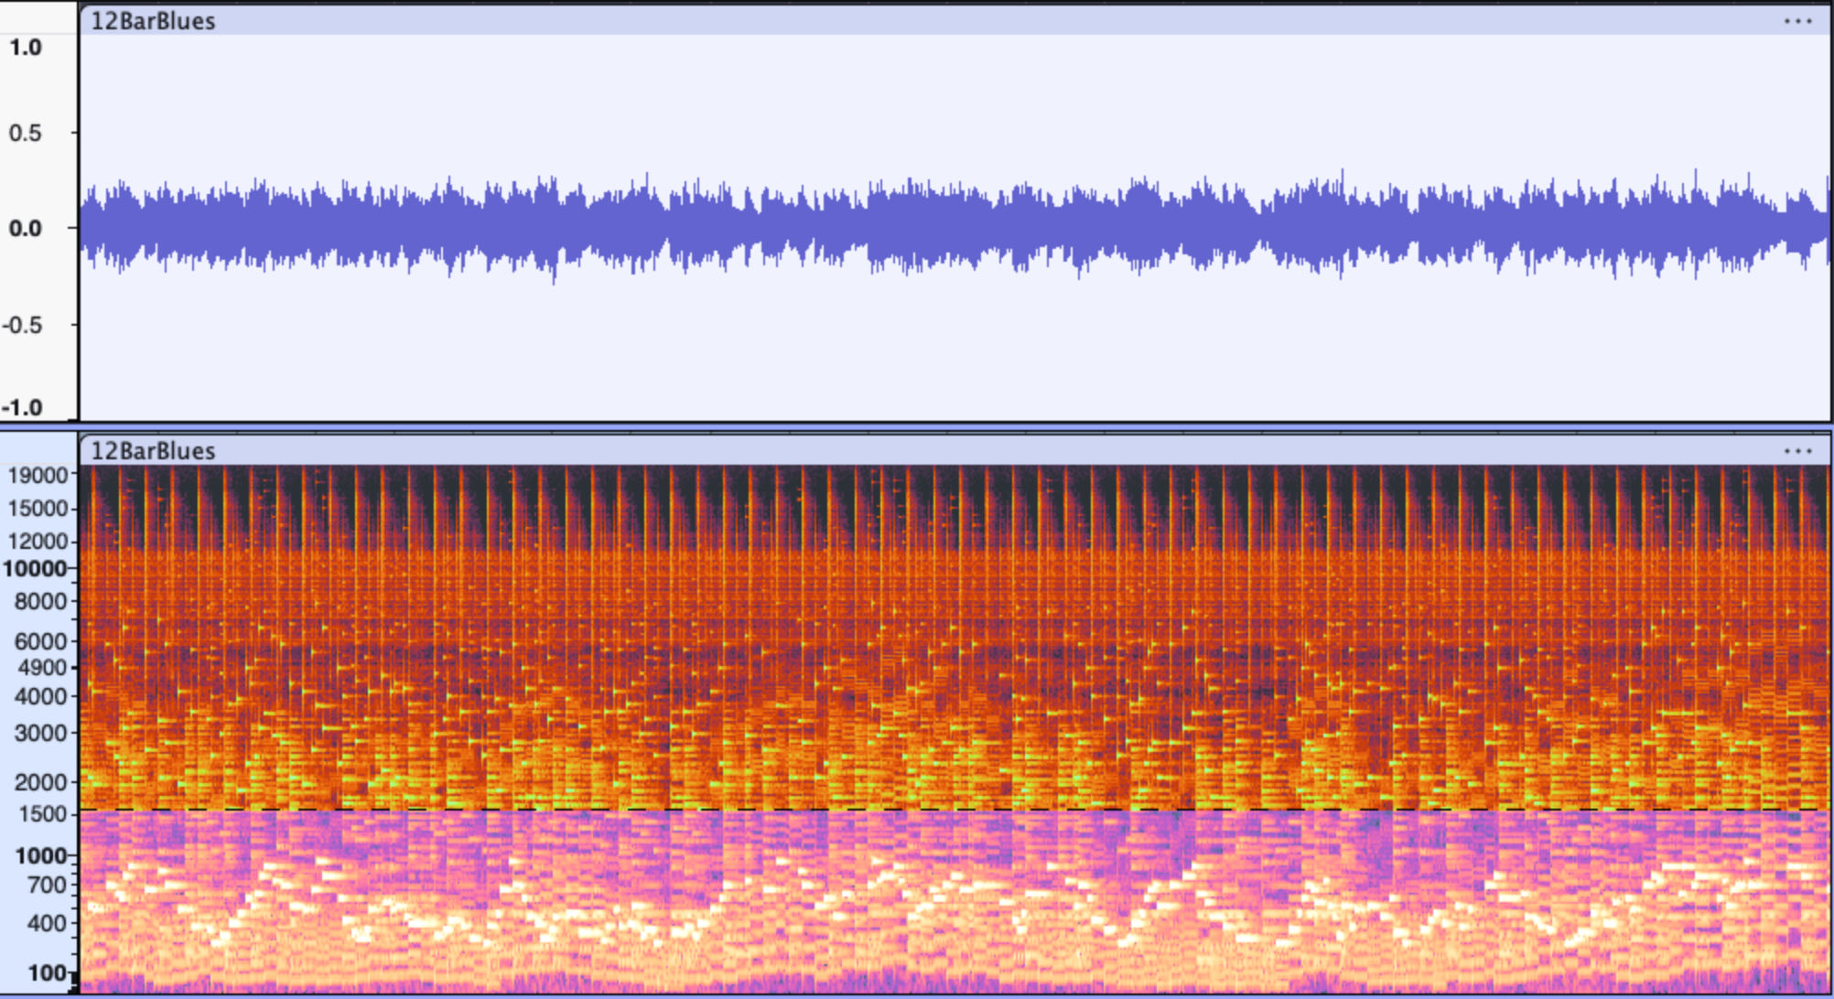
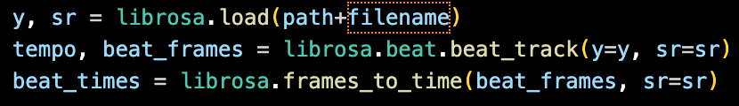
Acoustic cues
Y, sr
y= data as waveform
sr= sample rate
 | Tempo | microstructural irregularity
Anger | Fast | Irregularity
Fear | Fast | a lot of irregularity
Happiness | Fast | very little regularity
Sadness | Slow | irregularity
Tenderness | Slow | regularity
https://github.com/annajordanous/emovectors/
Notes:
Y, sr
y= data as waveform
sr= sample rate
https://librosa.org/doc/main/tutorial.html
"y, sr = librosa.load(filename)
loads and decodes the audio as a time series y, represented as a one-dimensional NumPy floating point array. The variable sr contains the sampling rate of y, that is, the number of samples per second of audio. By default, all audio is mixed to mono and resampled to 22050 Hz at load time."
https://librosa.org/doc/main/glossary.html#term-time-series
"time series
Typically an audio signal, denoted by y, and represented as a one-dimensional numpy.ndarray of floating-point values. y[t] corresponds to amplitude of the waveform at sample t."
Also
"sampling rate
The number of samples per second of a time series. This is denoted by a positive number sr.
frame
A short slice of a time series used for analysis purposes. This usually corresponds to a single column of a spectrogram matrix."
"spectrogram
A matrix S where the rows index frequency bins, and the columns index frames (time). Spectrograms can be either real-valued or complex-valued. By convention, real-valued spectrograms are denoted as numpy.ndarrays S, while complex-valued STFT matrices are denoted as D."

Slide 20
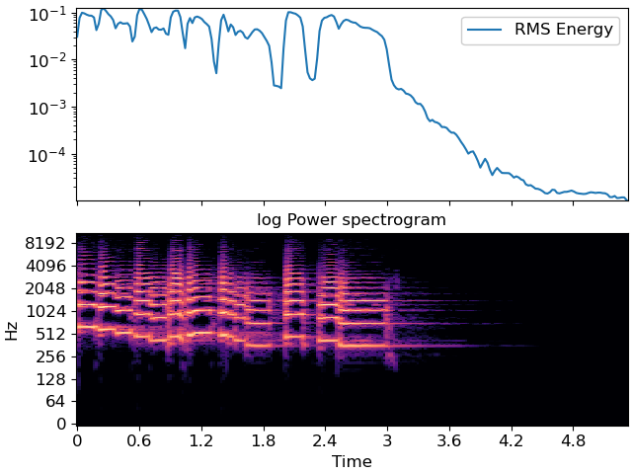
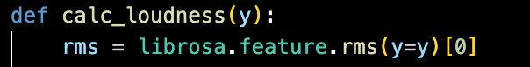
Acoustic cues
https://librosa.org/doc/main/generated/librosa.feature.rms.html
 | sound level | sound level variability
Anger | high | much
Fear | low | much
Happiness | medium–high | n/a
Sadness | low | little
Tenderness | low | little
https://github.com/annajordanous/emovectors/
Notes:
Rms
https://librosa.org/doc/main/generated/librosa.feature.rms.html
Root mean square – measure of the average loudness of an audio signal over a short period of time
"Compute root-mean-square (RMS) value for each frame, either from the audio samples y or from a spectrogram S.
Computing the RMS value from audio samples is faster as it doesn’t require a STFT calculation. However, using a spectrogram will give a more accurate representation of energy over time because its frames can be windowed, thus prefer using S if it’s already available."

Slide 21
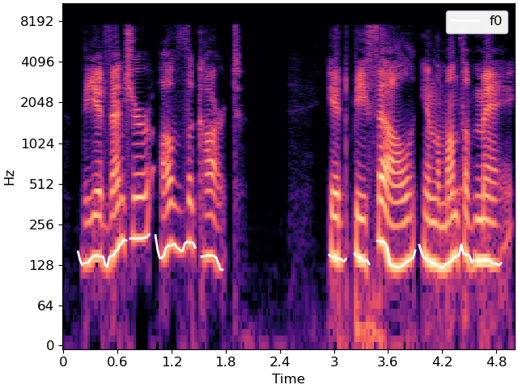
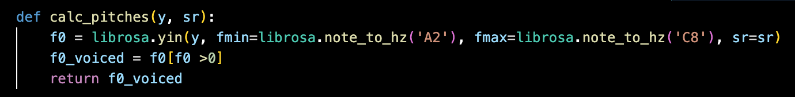
Acoustic cues
https://librosa.org/doc/main/auto_examples/plot_spectral_harmonics.html
 | pitch level | pitch variability
Anger | high | much
Fear | high | little
Happiness | high | much
Sadness | low | little
Tenderness | low | little
https://github.com/annajordanous/emovectors/
Notes:
"The figure above illustrates how the f0 contour tends to follow the lowest frequency with the most energy, which are indicated by bright colors toward the bottom of the image."

Slide 22
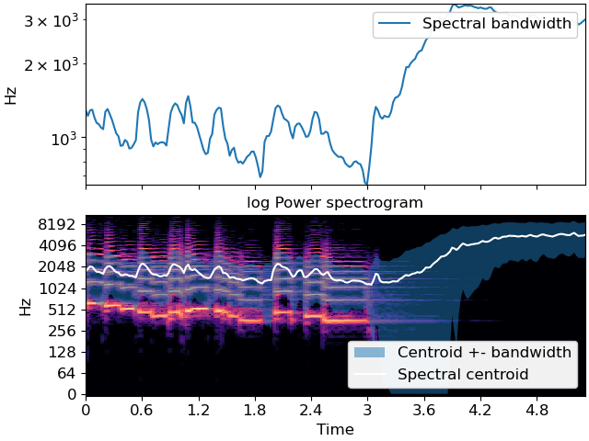
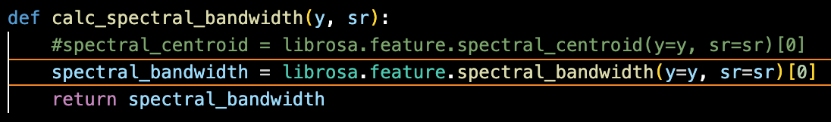
Acoustic cues
https://librosa.org/doc/main/generated/librosa.feature.spectral_bandwidth.html
 | high-frequency energy
Anger | much
Fear | little
Happiness | medium
Sadness | little
Tenderness | little
https://github.com/annajordanous/emovectors/
Notes:
Spectral bandwidth – *range* of frequencies/wavelengths associated with a signal at each time point
(difference between upper and lower frequencies)
NB centroid = central point

Slide 23
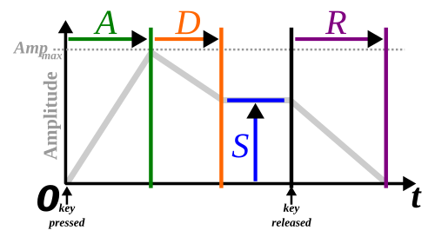
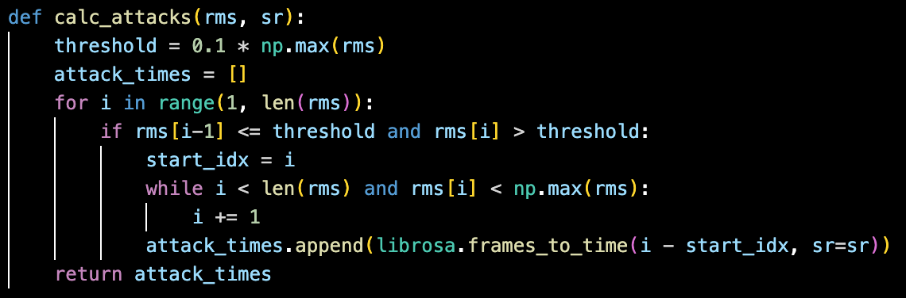
Acoustic cues
https://en.wikipedia.org/wiki/Envelope_(music)#/media/File:ADSR_parameter.svg
 | tone attacks
Anger | fast
Fear | n/a
Happiness | fast
Sadness | slow
Tenderness | slow
https://github.com/annajordanous/emovectors/

Slide 24
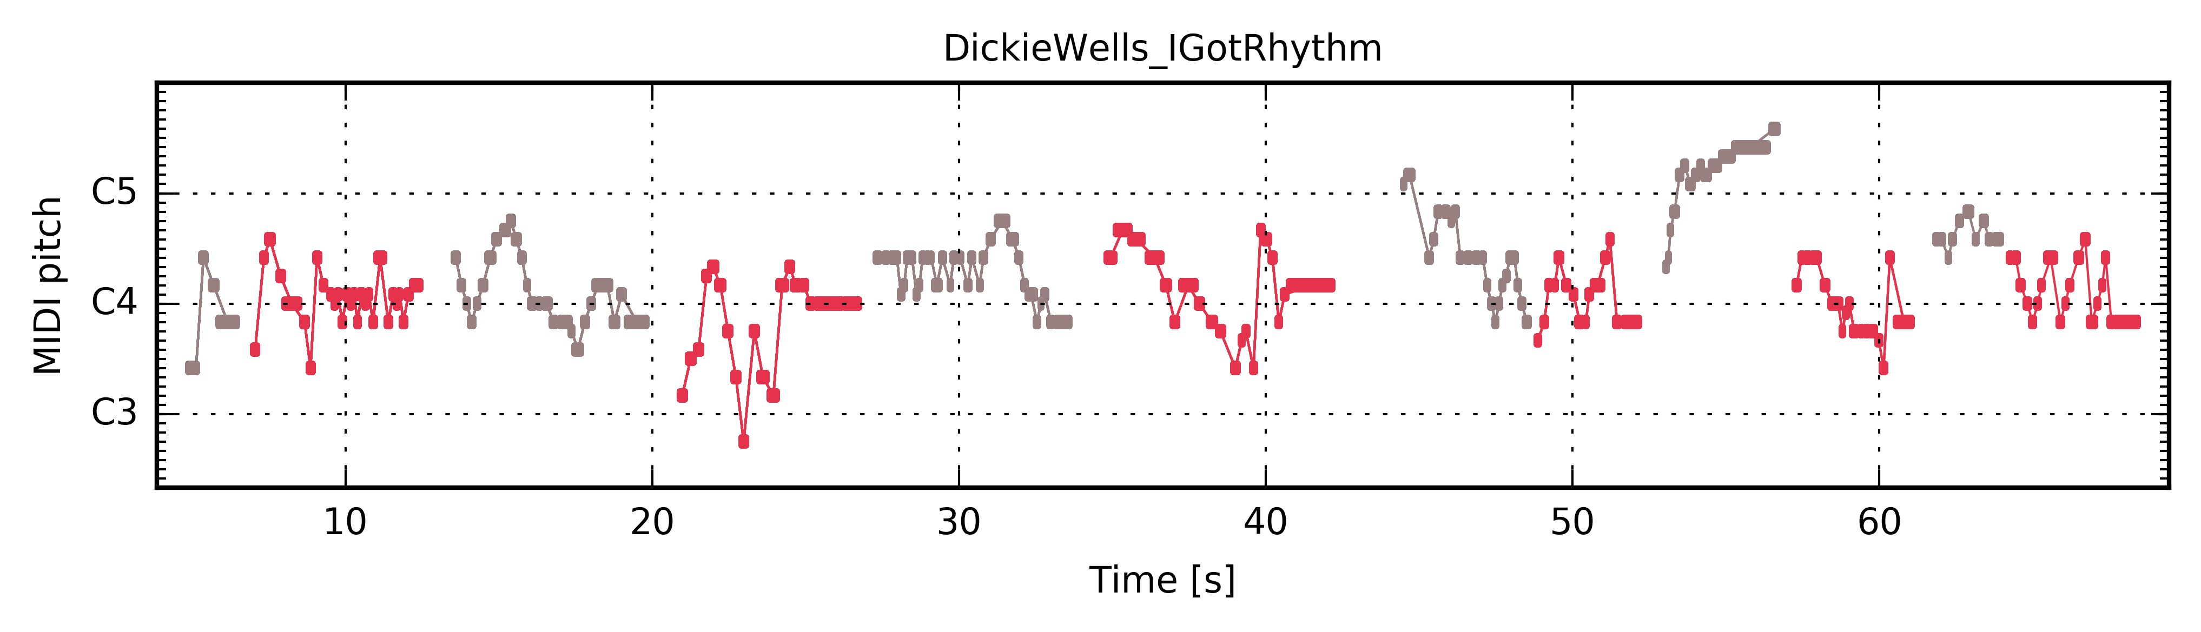
Acoustic cues
https://librosa.org/doc/main/auto_examples/plot_spectral_harmonics.html
 | pitch contour
Anger | rising
Fear | rising
Happiness | rising
Sadness | falling
Tenderness | falling
https://jazzomat.hfm-weimar.de/_images/PianoRoll_DickieWells_IGotRhythm.jpg
https://github.com/annajordanous/emovectors/

Slide 25

Results
jazz.00022.wav
{'anger': 1,
'fear': 0,
'happiness': 1,
'sadness': 1,
'tenderness': 0}
jazz.00030.wav
{'anger': 1,
'fear': 3,
'happiness': 2,
'sadness': 4,
'tenderness': 5}
jazz.00092.wav
{'anger': 2,
'fear': 0,
'happiness': 0,
'sadness': 1,
'tenderness': 0}
Notes:
count 100.000000 mean 8.480000 std 2.904125 min 2.000000 25% 6.000000 50% 8.000000 75% 10.000000 max 15.000000 Name: emotional_magnitude, dtype: float64
Max jazz.00030.wav {'anger': 1, 'fear': 3, 'happiness': 2, 'sadness': 4, 'tenderness': 5}
Min jazz.00088.wav {'anger': 1, 'fear': 0, 'happiness': 0, 'sadness': 0, 'tenderness': 1}
Nextmin jazz.00022.wav {'anger': 1, 'fear': 0, 'happiness': 1, 'sadness': 1, 'tenderness': 0}
Nextmin jazz.00092.wav {'anger': 2, 'fear': 0, 'happiness': 0, 'sadness': 1, 'tenderness': 0}
Alt 00092, 00022

Slide 26
Results
Anger
Fear
Happiness
Sadness
Tenderness
Notes:
Light green = anger
Peach = fear
Light purple = happiness
Light yellow = sadness
Light blue = tenderness

Slide 27





Results
Anger
Fear
Happiness
Sadness
Tenderness
Notes:
Light green = anger
Peach = fear
Light purple = happiness
Light yellow = sadness
Light blue = tenderness

Slide 28
Results
 | highest | lowest
Anger | 00056 | 00003
Fear | 00042 | 00008
Happiness | 00024 | 00004
Sadness | 00014 | 00011
Tenderness | 00003 | 00008
{'anger': 5, 'fear': 1, 'happiness': 1, 'sadness': 1, 'tenderness': 0}
{'anger': 0, 'fear': 3, 'happiness': 1, 'sadness': 4, 'tenderness': 4}
{'anger': 1, 'fear': 4, 'happiness': 2, 'sadness': 4, 'tenderness': 4}
{'anger': 2, 'fear': 0, 'happiness': 1, 'sadness': 1, 'tenderness': 0}
{'anger': 2, 'fear': 1, 'happiness': 4, 'sadness': 0, 'tenderness': 0}
{'anger': 3, 'fear': 3, 'happiness': 0, 'sadness': 4, 'tenderness': 3}
{'anger': 1, 'fear': 3, 'happiness': 0, 'sadness': 4, 'tenderness': 3}
{'anger': 1, 'fear': 1, 'happiness': 3, 'sadness': 0, 'tenderness': 0}
{'anger': 0, 'fear': 3, 'happiness': 1, 'sadness': 4, 'tenderness': 4}
{'anger': 2, 'fear': 0, 'happiness': 1, 'sadness': 1, 'tenderness': 0}
Notes:
anger count 100.000000 mean 1.940000 std 1.301281 min 0.000000 25% 1.000000 50% 2.000000 75% 3.000000 max 5.000000 Name: anger, dtype: float64 jazz.00056.wav jazz.00003.wav
fear count 100.000000 mean 1.490000 std 0.948098 min 0.000000 25% 1.000000 50% 1.000000 75% 2.000000 max 4.000000 Name: fear, dtype: float64 jazz.00042.wav jazz.00008.wav
happiness count 100.000000 mean 1.540000 std 0.978764 min 0.000000 25% 1.000000 50% 2.000000 75% 2.000000 max 4.000000 Name: happiness, dtype: float64 jazz.00024.wav jazz.00004.wav
sadness count 100.000000 mean 1.880000 std 1.216719 min 0.000000 25% 1.000000 50% 2.000000 75% 3.000000 max 5.000000 Name: sadness, dtype: float64 jazz.00093.wav jazz.00011.wav
tenderness count 100.000000 mean 1.630000 std 1.186243 min 0.000000 25% 1.000000 50% 2.000000 75% 2.000000 max 5.000000 Name: tenderness, dtype: float64 jazz.00030.wav jazz.00008.wav

Slide 29
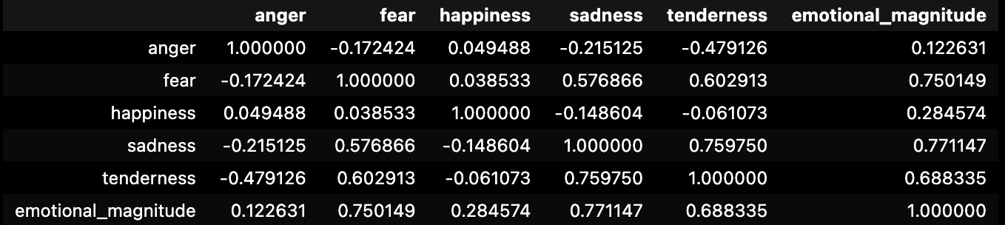
Results – correlations on GTZAN data
Notes:
angerfearhappinesssadnesstendernessemotional_magnitudeanger1.000000-0.1724240.049488-0.215125-0.4791260.122631fear-0.1724241.0000000.0385330.5768660.6029130.750149happiness0.0494880.0385331.000000-0.148604-0.0610730.284574sadness-0.2151250.576866-0.1486041.0000000.7597500.771147tenderness-0.4791260.602913-0.0610730.7597501.0000000.688335emotional_magnitude0.1226310.7501490.2845740.7711470.6883351.000000

Slide 30
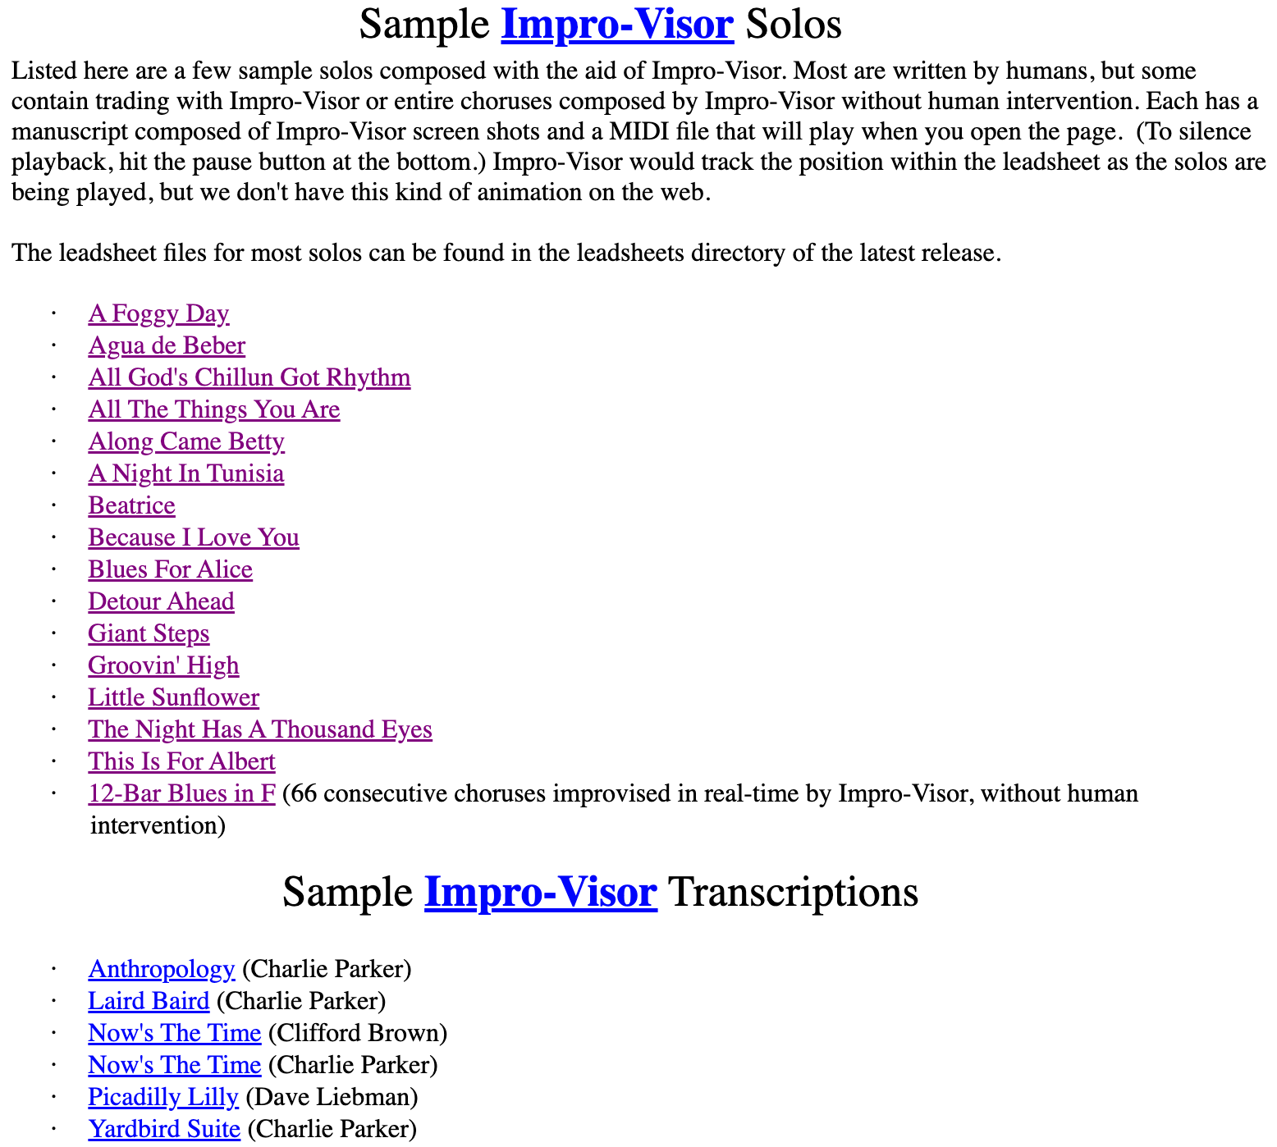
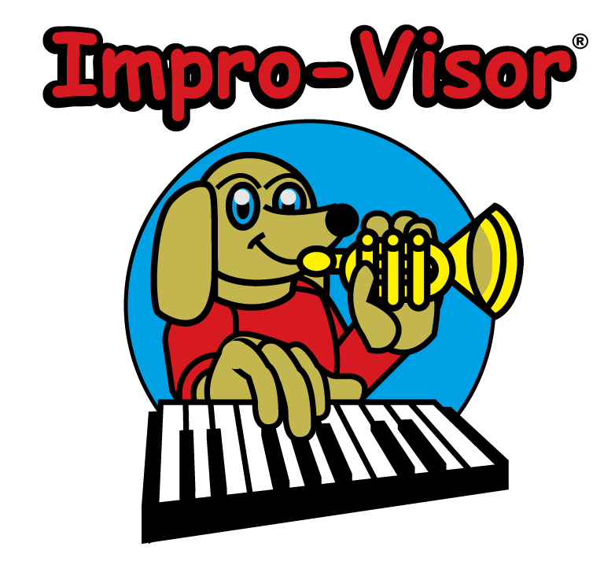
Results
https://www.cs.hmc.edu/%7Ekeller/jazz/improvisor/Solos/index.html

Slide 31
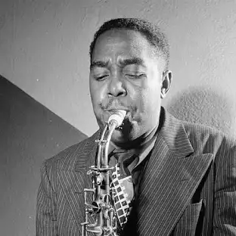
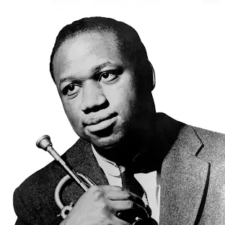
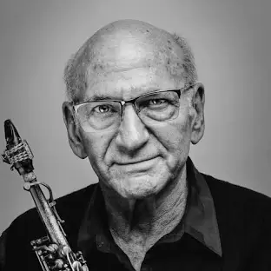
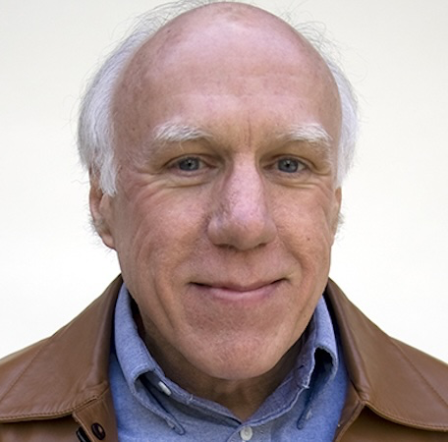
Results
(3sf) | Impro-visor (n=6) famous jazz solos | Impro-visor (n = 11) Bob Keller jazz solos
Anger | mean = 2.00 s.d = 0.894 | mean = 1.55 s.d = 1.13
Fear | mean = 2.00 s.d = 1.10 | mean = 1.36 s.d = 0.674
Happiness | mean = 1.33 s.d = 1.51 | mean = 1.09 s.d = 0.831
Sadness | mean = 2.00 s.d = 1.90 | mean = 1.73 s.d = 1.10
Tenderness | mean = 2.00 s.d = 1.55 | mean = 1.55 s.d = 1.04
emotional magnitude | mean = 9.33 s.d. = 1.63 | mean = 7.27 s.d. = 1.85

Slide 32
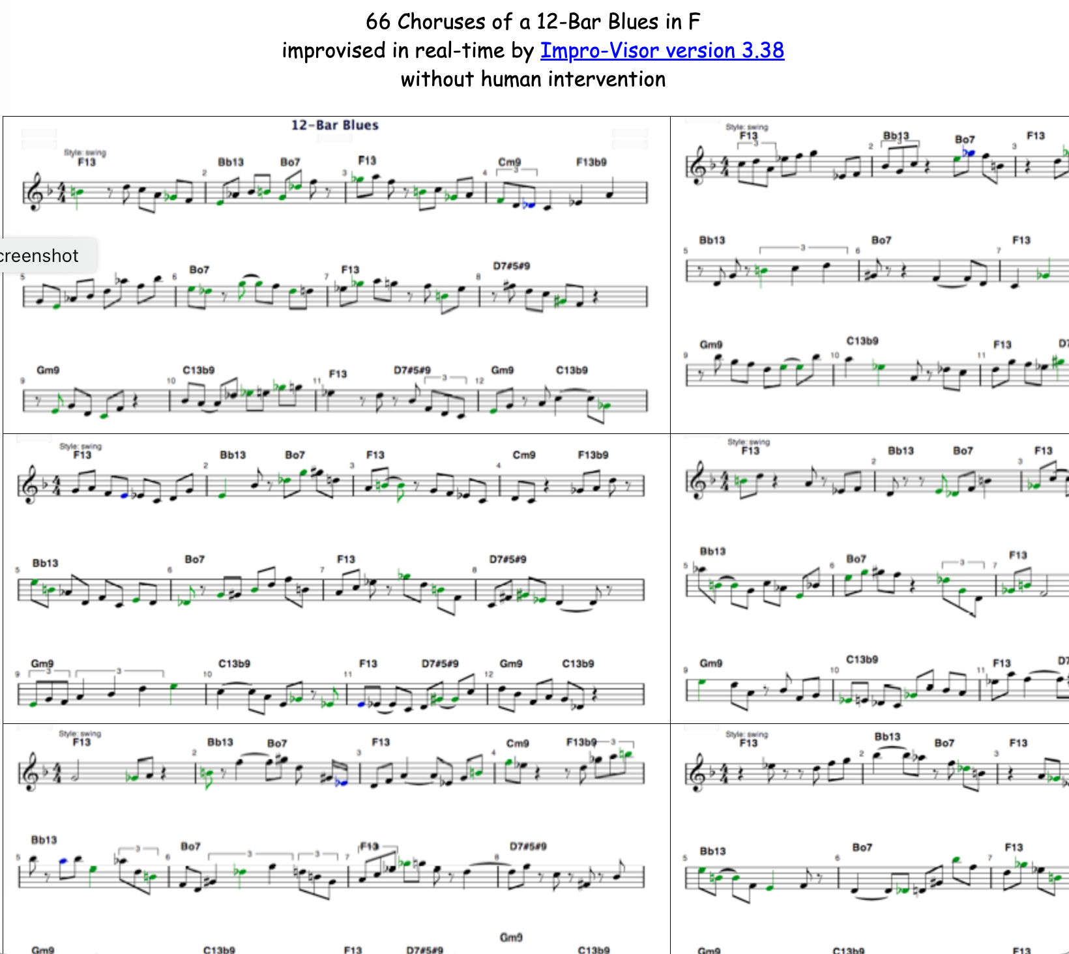
Results
https://www.cs.hmc.edu/%7Ekeller/jazz/improvisor/Solos/12BarBlues66Choruses.htm

Slide 33
Results
(3sf) | Impro-visor (n=6) famous jazz solos | Impro-visor (n = 11) Bob Keller jazz solos | Impro-visor (n = 8) Impro-visor jazz solos
Anger | mean = 2.00 s.d = 0.894 | mean = 1.55 s.d = 1.13 | mean = 1.50 s.d = 1.31
Fear | mean = 2.00 s.d = 1.10 | mean = 1.36 s.d = 0.674 | mean = 1.25 s.d = 1.58
Happiness | mean = 1.33 s.d = 1.51 | mean = 1.09 s.d = 0.831 | mean = 1.13 s.d = 0.835
Sadness | mean = 2.00 s.d = 1.90 | mean = 1.73 s.d = 1.10 | mean = 1.50 s.d = 0.926
Tenderness | mean = 2.00 s.d = 1.55 | mean = 1.55 s.d = 1.04 | mean = 1.250 s.d = 0.707
emotional magnitude | mean = 9.33 s.d. = 1.63 | mean = 7.27 s.d. = 1.85 | mean = 6.63 s.d. = 3.38

Slide 34
So What?
Hypothesis: if an improvisation contains more evidence of emotion-laden content, it is more likely to be recognised as creative
If this works, it supports the MOOsic project:
“This project investigates the hypothesis that we can approximate creativity evaluation with domain-specific evaluative tests , such that we can optimise for maximising creativity. … [this project] looks specifically at musical improvisation, and investigates how automated tests for musical improvisation creativity can be implemented and applied.

Slide 35
Next steps
Statistical analysis across songs matched to ranking to verify hypothesis
Better data for creativity rankings?
Validation with human participants?
• student projects (Alan Osys on MOO for game playability, Martin East on MOO for jewellery design, Timothy Popoola for music metrics that can be used in MOO)
TODO: submit paper
TODO: submit grant proposal
Notes:
• intention - can this be captured by showing presence of a musical narrative? How? • how does the chord sequence influence creativity potential? Future work on optimising chord sequences for creativity • could analyse creativity of an individual artist across different groups.. see in what groups they (collectively) produce most creative impro..... but difficult to do without
• isolating individual improvisations vs analysing the whole track- this needs to be clearly linked to the rankings • rankings need to be very solid benchmarks • Is the impro creative because of the individual improvising, or the group? I assume collective creativity - why? Because music impro is inherently social (citation) and group impro is constructed around interaction (cite, jazz theory examples too) * to what extent does the chord sequence/ lead sheet melody influence creativity? In this work, this is controlled for through analysing multiple examples over the same chord sequence. Where possible, will also compare improvisations seeded from different lead sheet melodies, using the same chord sequence eg 12 bar blues, rhythm changes * Rankings will be biased by popularity of the musicians involved and how well known they are - control by looking at tracks matched by rough date, and also will be interesting to evaluate newer tracks by lesser known artists - can I detect up and coming stars? (Can use spotipy for metadata on artist popularity, will need to be scaled relative to all jazz artists in my dataset) * jazz is a term that covers many sub genres, how appropriate is it to compare, say free jazz to dixie? ..... maybe can check this in analysis if deep enough data * what about improvisations that aren't jazz? Maybe i need to be careful here and say 'impro' rather than jazz, though that might not work as the leadsheet/chord sequence idea is inspired by jazz. I need to be careful how to frame this. I can emphasise my scope is on improvisations around a lead sheet/ chord sequence model (explain what this is), typically but not exclusively found in jazz impro... acknowledging too that not all jazz is in this model (I can cite Alex Hawkins as example!) * I assume that for J&L all audio features contribute equally to the emotion... check original paper and any follow up work. Can i validate this against any annotated datasets (ideally jazz)? Is this actually the first paper? * is it worth doing analysis across an artist, to calculate their most creative impro? Might be verifiable against people's rankings? Controversial again otherwise, but possible. Difficulty with groups- what is the artist? The lead name on the record? Or that specific combination of musicians? Could be a fun initial experiment pointing to future work?

Slide 36
Summary: Measuring intention and emotional involvement in jazz music
Overview of this work in progress
Part of a wider project on optimising AI for creativity
Hypothesis: if an improvisation contains more evidence of emotion-laden content, it is more likely to be recognised as creative
Background
Creativity in music improvisation
Emotions in music
Methodology and results so far
Some promising results starting to appear
So What? and Next steps
Notes:
Hypothesis: • if an improvisation contains more evidence of emotion-laden content, it is more likely to be recognised as creative What do I need • data ranking most creative improvisations • data for multiple improvisations • ml model eg transformer trained on valence/arousal (soleymani et al?) - benetos et al 2021? Assumption that git repo using Spotipy won't work any more • library to calculate J&L features - librosa? Super collider? • do I want to get human input for validation? Or is the ranking enough? • Data on popularity of artists in dataset (spotipy?) • Literature survey on MER music emotion recognition, especially anything looking at creativity- MAY INFLUENCE METHOD • Stats method to analyse results across songs • organising data into sets for analysis, need to cross check against data on popularity+year as well as matching across a lead sheet • check for different songs with same name eg moaning Method • collect data as above • implement J&L features for input audio with 5d vector as output (is this actually the first paper? See issues)(and Russell model? With 2d output vector, to see if overall emotion has effect). Output = emovectors? (Check if that had been used) • Get emovectors :) for each song in analysis data • Statistical analysis across songs matched to ranking to verify hypothesis Issues • isolating individual improvisations vs analysing the whole track- this needs to be clearly linked to the rankings • rankings need to be very solid benchmarks • Is the impro creative because of the individual improvising, or the group? I assume collective creativity - why? Because music impro is inherently social (citation) and group impro is constructed around interaction (cite, jazz theory examples too) * to what extent does the chord sequence/ lead sheet melody influence creativity? In this work, this is controlled for through analysing multiple examples over the same chord sequence. Where possible, will also compare improvisations seeded from different lead sheet melodies, using the same chord sequence eg 12 bar blues, rhythm changes * Rankings will be biased by popularity of the musicians involved and how well known they are - control by looking at tracks matched by rough date, and also will be interesting to evaluate newer tracks by lesser known artists - can I detect up and coming stars? (Can use spotipy for metadata on artist popularity, will need to be scaled relative to all jazz artists in my dataset) * jazz is a term that covers many sub genres, how appropriate is it to compare, say free jazz to dixie? ..... maybe can check this in analysis if deep enough data * what about improvisations that aren't jazz? Maybe i need to be careful here and say 'impro' rather than jazz, though that might not work as the leadsheet/chord sequence idea is inspired by jazz. I need to be careful how to frame this. I can emphasise my scope is on improvisations around a lead sheet/ chord sequence model (explain what this is), typically but not exclusively found in jazz impro... acknowledging too that not all jazz is in this model (I can cite Alex Hawkins as example!) * I assume that for J&L all audio features contribute equally to the emotion... check original paper and any follow up work. Can i validate this against any annotated datasets (ideally jazz)? Is this actually the first paper? * is it worth doing analysis across an artist, to calculate their most creative impro? Might be verifiable against people's rankings? Controversial again otherwise, but possible. Difficulty with groups- what is the artist? The lead name on the record? Or that specific combination of musicians? Could be a fun initial experiment pointing to future work? Assumptions: * Improvisation is creative process where the outputs are closely tied to the live process. • emotional content in the music can be used as a proxy for emotional involvement • emotional content can be represented using either Russell valence and arousal model or the 5 key emotions as captured by Juslin and Laukka. Russell ok for summative but not for magnitude, so J&L better? • Intention and emotional involvement are recognised outside my work, as part of the key contributors to musical creativity (alongside social interaction and communication, and domain competence) • I can use 'song' or 'chart' to represent lead sheet plus chord (chart probably better, but more confusing for a non jazzer?) Future work • intention - can this be captured by showing presence of a musical narrative? How? • how does the chord sequence influence creativity potential? Future work on optimising chord sequences for creativity • could analyse creativity of an individual artist across different groups.. see in what groups they (collectively) produce most creative impro..... but difficult to do without

